Slide 1

CapsTONE PROJECT
THE BATTLE OF NEIGHBOURHOODS

Slide 2
INTRODUCTION
Toronto is the provincial capital of Ontario. It is a prominent centre for music, theatre, motion picture production, and television production, and is home to the headquarters of Canada's major national broadcast networks and media outlets.
With diverse culture and populous area, the city of Toronto has potential for expansion and buildout. There is window of opportunity for construction companies, businessmen, entrepreneur and other possible developments. These are the some of possible clients or people who would be interested in this project.

Slide 3
PROBLEM
In this project, we try to find answers to following questions:
What type of venues are available in each neighbourhood in Toronto?
List the places not available in neighbourhood and can be build for development.
Find area having potential to build a chain of store and type of establishment.
Places that lacks venues.
Find type or common venues in neighbourhood.

Slide 4
DATA SECTION
For the project we need the following data:
Toronto data that contain lists of boroughs and neighbourhoods along with their latitude and longitude
Data Source: https://en.wikipedia.org/wiki/List_of_postal_codes_of_Canada:_M
Data Description: Data source contain table with list of Postal Code in the city and the borough and neighbourhood assigned to it.
List and map of venues and venue category in each neighbourhood
Data source: Foursquare API and Python packages
Data Description: Foursquare API give list of venues and category. Packages like geopy will give us latitude and longitude of any location while folium helps in visualizing everything on map with labels.

Slide 5
METHODOLOGY
Split the data and make separate dataframe for each borough to analyse
List out all venues and venue categories in each borough.
Find all venue categories and find venue not available in borough
Find potential venue category which can be opened and build in that borough.

Slide 6
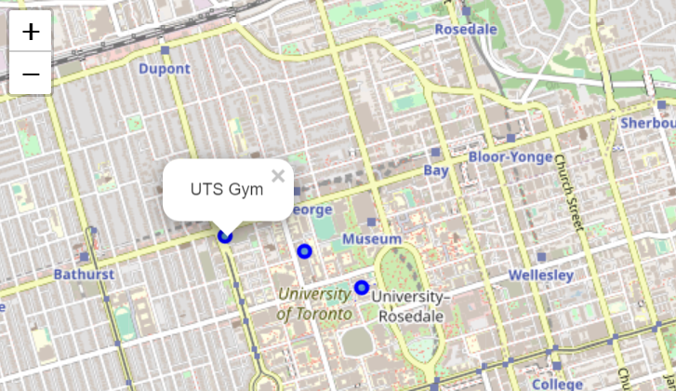
Search result for gym near University of Toronto

Slide 7
ResULT
We have table for each borough tabulating each venue along with its address, latitude, longitude, venue category and its neighbourhood detail.
We find that ‘Field, Farm, River, College Stadium’ are some of the categories not present in most of the borough.
We find that Mississauga and York has least number of venues. All neighbourhoods except some in Downtown Toronto and North York has potential for construction and developments on large scale.
We find that there are certain sites present in most of the neighbourhoods like Coffee shop, bar, restaurants, etc.
It is easy for a person to query nearby venues entering its exact address.

